Slide 1

SWOT Analysis & Design Change Report for Mobile E‑commerce Interface
Evaluating key factors shaping mobile shopping experience
BY: Joshua Zimmerman-Gibson
1/11/2026

Slide 2

Introduction & Executive Summary
Notes:
---
This slide references information from the following file: https://docslib.org/doc/1305595/a-useful-guide-to-swot-analysis,https://parkdale.digital/blogs/news/baymard-institute-2024-checkout-usability-research,https://blog.hubspot.com/marketing/swot-analysis,https://www.jpmorgan.com/insights/payments/security-trust/pci-compliance-guide-protect-payment-data-and-prevent-fraud,https://www.primefactors.com/resources/blog/payments/complying-with-pci-dss-4-0/

Slide 3
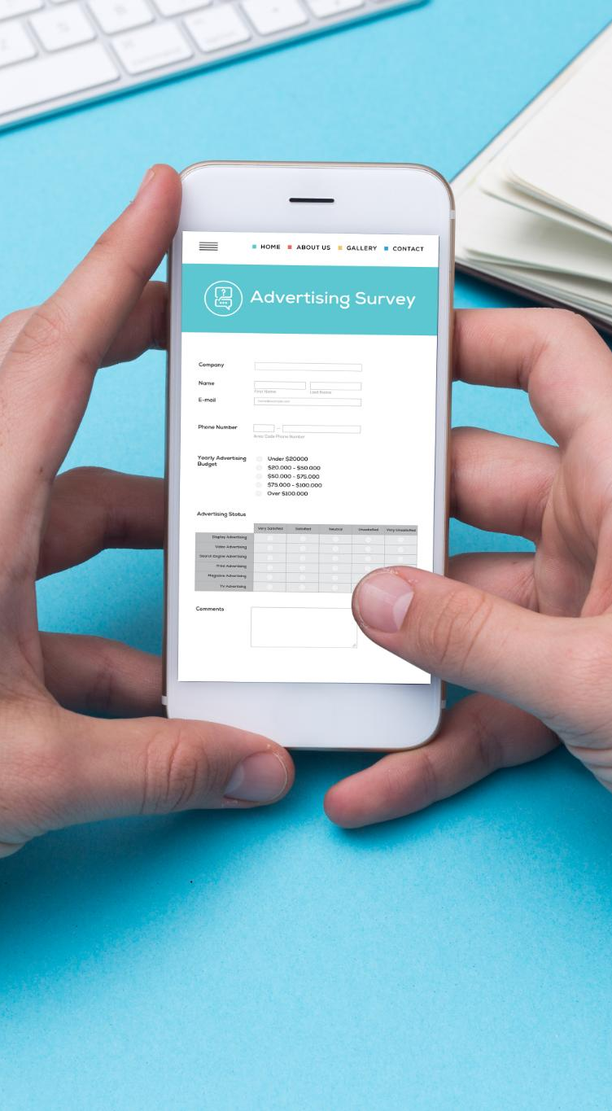
Purpose and Context
Research Focus Areas
  User research targeted sign-up, checkout, and payment screens to identify usability issues impacting conversion rates.
SWOT Framework Purpose
  SWOT analysis distinguishes internal strengths and weaknesses from external opportunities and threats for strategic improvements.
Addressing Usability & Compliance
  Improving user experience involves reducing cart abandonment and ensuring compliance with standards like PCI DSS.
Presentation Roadmap
  The deck includes SWOT matrix, detailed assessments, design changes, and an implementation roadmap with KPIs.
Notes:
---
This slide references information from the following file: https://docslib.org/doc/1305595/a-useful-guide-to-swot-analysis,https://parkdale.digital/blogs/news/baymard-institute-2024-checkout-usability-research,https://blog.hubspot.com/marketing/swot-analysis,https://www.jpmorgan.com/insights/payments/security-trust/pci-compliance-guide-protect-payment-data-and-prevent-fraud,https://www.primefactors.com/resources/blog/payments/complying-with-pci-dss-4-0/
This presentation summarizes the findings from prior user research on a mobile e-commerce interface, focusing on sign-up, checkout, and payment screens. The goal is to translate these findings into a structured SWOT analysis and actionable design changes. The SWOT framework helps distinguish internal factors (strengths and weaknesses) from external factors (opportunities and threats), enabling strategic improvements. Research revealed high cart abandonment rates and usability issues that impact conversion. By addressing these issues and aligning with industry best practices and compliance standards such as PCI DSS, we can significantly improve user experience and trust. This deck will cover the SWOT matrix, detailed assessments, proposed design changes, and an implementation roadmap with KPIs to measure success.

Slide 4
SWOT Matrix Overview
Notes:
---
This slide references information from the following file: https://parkdale.digital/blogs/news/baymard-institute-2024-checkout-usability-research,https://blog.hubspot.com/marketing/swot-analysis,https://www.jpmorgan.com/insights/payments/security-trust/pci-compliance-guide-protect-payment-data-and-prevent-fraud,https://www.primefactors.com/resources/blog/payments/complying-with-pci-dss-4-0/

Slide 5

SWOT Summary Table
Strengths Overview
  User interface is clean and uncluttered with clear visual hierarchy and visible cart totals. Social sign-in options and consistent CTAs improve usability.
Weaknesses Identified
  Password rules are hidden and CTA wording causes anxiety. Trust cues near card entry are limited and fee transparency is lacking.
Opportunities for Improvement
  Adding popular wallets, alternative payment methods, and showing delivery dates can enhance checkout usability and trust alignment with PCI DSS.
Threats to Address
  High abandonment rates and evolving compliance requirements pose challenges. Competitors offer one-tap wallets and consumers are sensitive to payment security.
Notes:
---
This slide references information from the following file: https://parkdale.digital/blogs/news/baymard-institute-2024-checkout-usability-research,https://blog.hubspot.com/marketing/swot-analysis,https://www.jpmorgan.com/insights/payments/security-trust/pci-compliance-guide-protect-payment-data-and-prevent-fraud,https://www.primefactors.com/resources/blog/payments/complying-with-pci-dss-4-0/
The SWOT matrix organizes insights into four quadrants:
Strengths: Clean, uncluttered UI with clear visual hierarchy; social sign-in options; visible cart totals; consistent CTAs with adequate tap targets.
Weaknesses: Hidden password rules; anxiety-inducing CTA wording; limited trust cues near card entry; lack of fee/tax transparency; poor card input ergonomics.
Opportunities: Implement research-backed checkout best practices; add popular wallets and alternative payment methods; show delivery dates and cutoff countdowns; align trust messaging with PCI DSS.
Threats: High industry-wide abandonment rates; evolving PCI DSS compliance requirements; competitors offering one-tap wallets; rising consumer sensitivity to payment security.

Slide 6
Detailed SWOT Assessments
Notes:
Internal Strengths, Internal Weaknesses, External Opportunities, External Threats

Slide 7
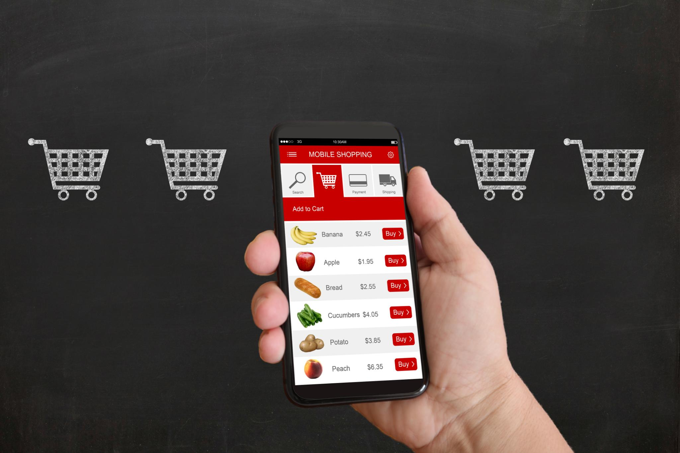
Internal Strengths
Visual Clarity in Checkout
  Clear and simple checkout design reduces cognitive load and helps users make quick decisions confidently.
Social Sign-In Integration
  Social sign-in options offer a low-friction login path for returning users, improving convenience and speed.
Consistent and Strong CTAs
  Consistent call-to-action buttons with strong contrast and ample touch targets reduce user errors and boost efficiency.
Notes:
Strengths include visual clarity in checkout, which reduces cognitive load and aids quick decision-making. Social sign-in options provide a low-friction path for returning users, while consistent CTAs with strong contrast and adequate touch targets support error prevention and efficiency. These factors collectively enhance usability and user confidence during critical steps of the purchase journey.

Slide 8
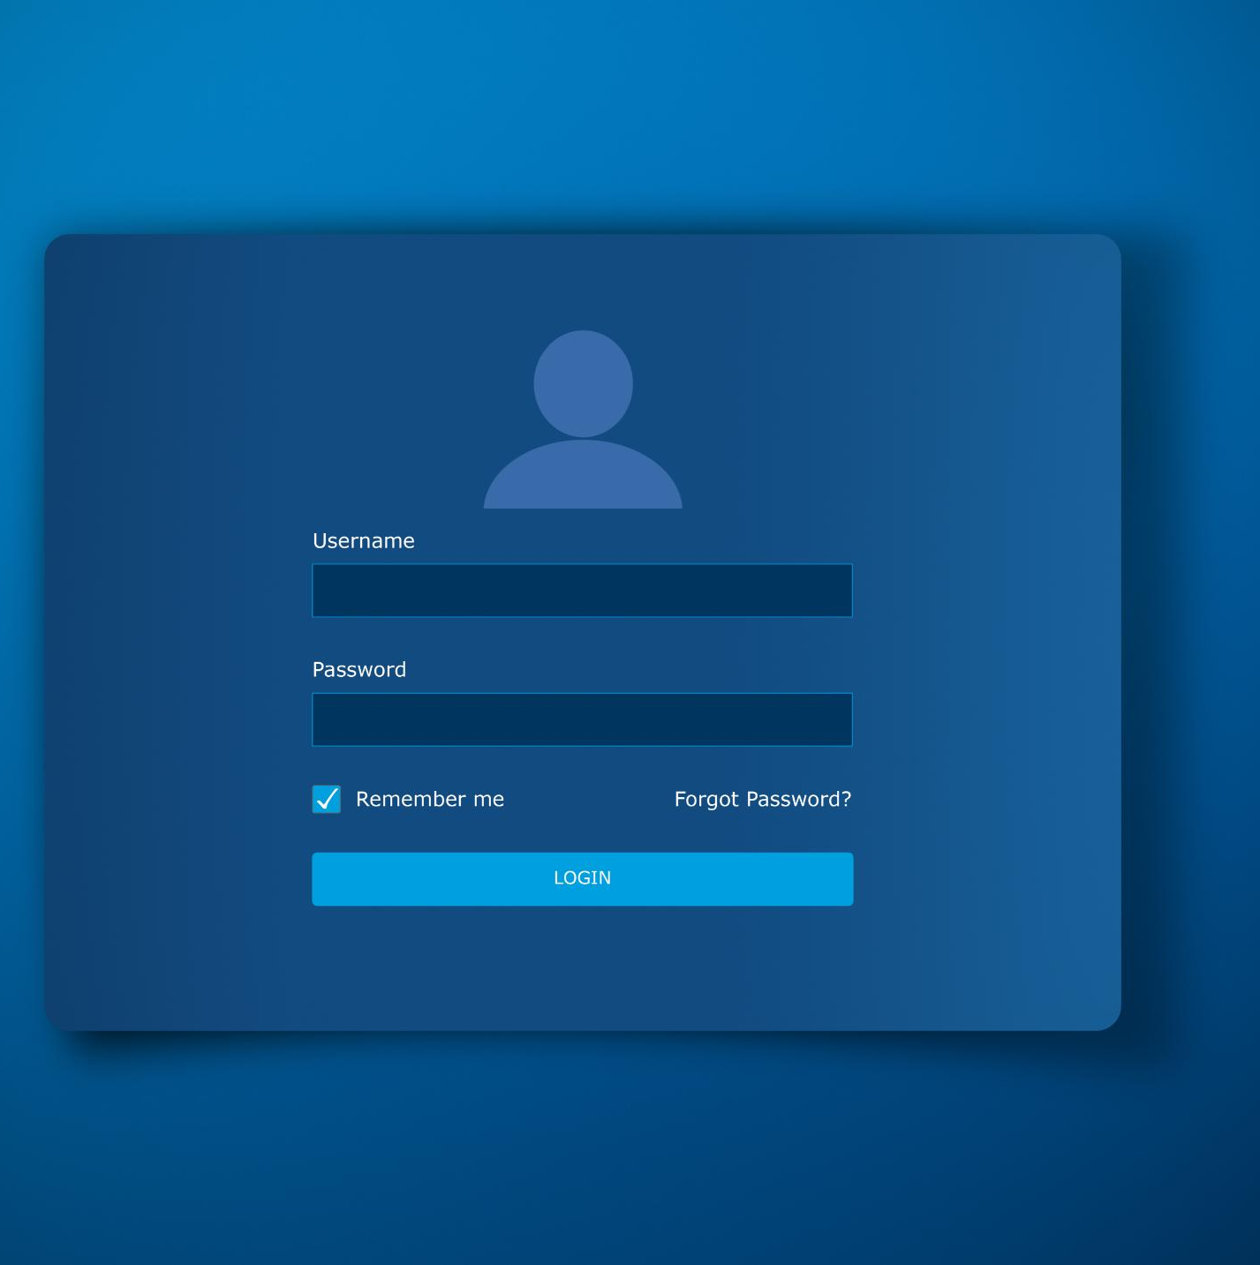
Internal Weaknesses
Password Visibility Issues
  Poor visibility of password requirements causes user hesitation and input errors during form completion.
Anxiety-Provoking CTAs
  Calls to action like 'Buy now' and 'Pay now' create uncertainty and anxiety, reducing user confidence.
Trust Cue Deficiency
  Insufficient trust cues near card input fields increase user doubt and decrease form completion rates.
Poor Card Entry Ergonomics
  Missing auto-formatting and weak error feedback in card entry frustrate users and increase abandonment risk.
Notes:
Weaknesses identified include poor password requirement visibility, causing user hesitation and errors; anxiety-provoking CTAs such as 'Buy now' and 'Pay now' that create uncertainty; insufficient trust cues near card fields; lack of early fee/tax transparency; and inadequate card entry ergonomics, such as missing auto-formatting and weak error feedback. These issues increase friction and abandonment risk.

Slide 9
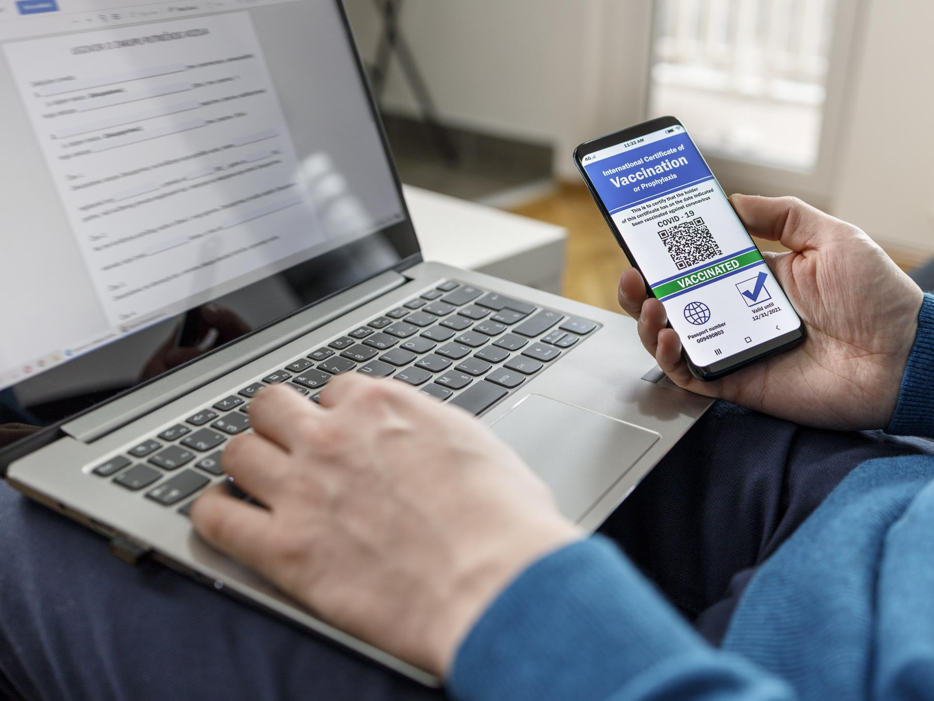
External Opportunities
Checkout UX Best Practices
  Implementing proven checkout UX techniques reduces cart abandonment and enhances user experience.
Popular Digital Wallets
  Adding Apple Pay and Google Pay meets user expectations and simplifies payment processes.
Delivery Dates and Timers
  Displaying delivery dates and dynamic cutoff timers provides clarity and urgency for customers.
Trust Through Security Messaging
  Reinforcing trust with PCI DSS-aligned messaging boosts user confidence during checkout.
Notes:
Opportunities include implementing proven checkout UX best practices to reduce abandonment, adding popular wallets like Apple Pay and Google Pay to meet user expectations, displaying delivery dates and dynamic cutoff timers for clarity, and reinforcing trust through PCI DSS-aligned messaging. These changes can improve conversion rates and user confidence significantly.

Slide 10

External Threats
High Abandonment Rates
  Persistent high abandonment rates impact revenue and indicate friction in the payment process.
PCI DSS Compliance Risks
  Stricter PCI DSS compliance requirements increase regulatory risks and operational challenges.
Competitive Payment Solutions
  Competitors offering seamless one-tap wallet experiences attract customers with convenience.
Consumer Security Concerns
  Growing consumer concerns about payment security can erode brand trust and loyalty.
Notes:
Threats include persistent high abandonment rates across the industry, stricter PCI DSS compliance requirements that pose regulatory risks, competitors offering seamless one-tap wallet experiences, and growing consumer concerns about payment security. Failure to address these threats could result in lost revenue and diminished brand trust.

Slide 11

Design Changes Proposed
Notes:
---
This slide references information from the following file: https://blog.hubspot.com/marketing/swot-analysis,https://www.jpmorgan.com/insights/payments/security-trust/pci-compliance-guide-protect-payment-data-and-prevent-fraud,https://www.primefactors.com/resources/blog/payments/complying-with-pci-dss-4-0/

Slide 12
Actionable Recommendations
Password Validation Enhancements
  Add inline password rules and real-time strength validation to improve user experience and security.
Payment Process Improvements
  Rename CTAs to reduce anxiety and provide trust cues near card fields for secure transactions.
Cost Transparency Features
  Show early visibility of estimated taxes, shipping costs, and delivery dates with expandable details.
User-Friendly Input Controls
  Improve card entry ergonomics, integrate wallets, mark required fields, and use plus/minus quantity buttons.
Notes:
---
This slide references information from the following file: https://blog.hubspot.com/marketing/swot-analysis,https://www.jpmorgan.com/insights/payments/security-trust/pci-compliance-guide-protect-payment-data-and-prevent-fraud,https://www.primefactors.com/resources/blog/payments/complying-with-pci-dss-4-0/
Based on the SWOT analysis, the following design changes are recommended:
1. Add inline password rules and real-time validation with strength indicators.
2. Rename CTAs to reduce anxiety, e.g., 'Proceed to payment' followed by 'Place order'.
3. Provide early visibility of estimated taxes and shipping costs with expandable breakdowns.
4. Display trust cues near card fields, including lock icons and PCI DSS compliance statements.
5. Improve card entry ergonomics with auto-formatting, Luhn validation, and clear error messages.
6. Integrate popular wallets and alternative payment methods.
7. Mark required and optional fields explicitly; hide uncommon optional fields behind expanders.
8. Show delivery dates and dynamic cutoff countdowns.
9. Use plus/minus buttons with text fields for quantity adjustments to reduce input errors.

Slide 13

Implementation & Measurement
Notes:
Roadmap and KPIs

Slide 14

Roadmap and KPIs
Sprint Implementation Plan
  Development is divided into four sprints each targeting specific UX and feature improvements for a smoother payment experience.
Key Performance Indicators
  KPIs such as task completion rate, error rate, and conversion rate will measure the impact of design changes and user satisfaction.
Iterative Improvement Process
  Metrics will guide continuous improvements ensuring that design changes enhance usability and trust throughout the payment steps.
Notes:
Implementation will occur in sprints: Sprint 1 focuses on microcopy and password UX; Sprint 2 addresses card field formatting and trust cues; Sprint 3 introduces fee breakdowns, delivery dates, and quantity controls; Sprint 4 adds wallet integrations and analytics. KPIs include task completion rate, time on payment step, error rate per field, abandonment at each step, conversion rate, SUS scores, and post-purchase trust ratings. These metrics will validate the impact of design changes and guide iterative improvements.

Slide 15
References
Sarsby, A. (2012). A useful guide to SWOT analysis. Pansophix.
Baymard Institute. (n.d.). E‑commerce checkout usability: An original research study.
Baymard Institute. (2025, November 25). Checkout UX 2025: 10 pitfalls and best practices.
Baymard Institute. (2017). Checkout optimization & reducing abandonments: Six ways to retain users from “Add to Cart” through order completion.
PCI Security Standards Council. (2008). PCI data storage do’s and don’ts.
PCI Security Standards Council. (2024, June). Payment Card Industry Data Security Standard (PCI DSS) v4.0.1: Requirements and testing procedures.
Notes:
---
This slide references information from the following file: https://docslib.org/doc/1305595/a-useful-guide-to-swot-analysis,https://parkdale.digital/blogs/news/baymard-institute-2024-checkout-usability-research,https://blog.hubspot.com/marketing/swot-analysis,https://www.jpmorgan.com/insights/payments/security-trust/pci-compliance-guide-protect-payment-data-and-prevent-fraud,https://www.primefactors.com/resources/blog/payments/complying-with-pci-dss-4-0/
Baymard Institute. (n.d.). E-commerce checkout usability: An original research study. https://baymard.com/research/checkout-usability
Baymard Institute. (2025, November 25). Checkout UX 2025: 10 pitfalls and best practices. https://baymard.com/blog/current-state-of-checkout-ux
Baymard Institute. (2017). Checkout optimization & reducing abandonments: Six ways to retain users from “Add to Cart” through order completion. https://m.media-amazon.com/images/G/02/amazonservices/payments/website/Baymard_Report_Final._CB512367315_.pdf
PCI Security Standards Council. (2008). PCI data storage do’s and don’ts. https://www.pcisecuritystandards.org/pdfs/pci_fs_data_storage.pdf
PCI Security Standards Council. (2024, June). Payment Card Industry Data Security Standard (PCI DSS) v4.0.1: Requirements and testing procedures. https://www.middlebury.edu/sites/default/files/2025-01/PCI-DSS-v4_0_1.pdf
Sarsby, A. (2012). A useful guide to SWOT analysis. Pansophix. https://pdf4pro.com/file/1168ba/media_6158020_a_useful_guide_to_swot_analysis.pdf.pdf

